Slide 1
Computational Seismology
Theory and Practice
Rongjiang Wang
Helmholtz Centre Potsdam
GFZ German Research Centre for Geosciences
wang@gfz-potsdam.de

Slide 2
Content
Introduction
Theory of earthquake deformation
Equations of motion
Spectral solution method
Propagator algorithm
Seismic sources
Numerical problems and solutions
Loss-of-precision problem and orthonormalization of Haskell propagator
Time-domain aliasing and Laplace transform instead of Fourier transform
Space-domain aliasing and the differential transform
EDGRN/EDCMP - Computation of coseismic static deformation
Green’s function approach
Analytical Okada’s solutions based on a homogeneous halfspace model
Layering effect
Exercises with EDGRN/EDCMP
PSGRN/PSCMP – Computation of postseismic viscoelastic deformation
Various mechanisms for postseismic deformation
Viscoelasticity and the correspondence principle
The gravity effect
Exercises with PSGRN/PSCMP

Slide 3
Content (continue)
QSEIS – Computation of synthetic seismograms based on a stratified plane earth model
Earth flattening transform
Various partial solution filters (options)
Different source and receiver site structures
Exercises
QSSP – Computation of complete synthetic seismograms based on a self-gravitating earth model with the atmosphere-ocean-mantle-core structure
Normal mode theory, effect of gravity and self-gravitation
Hybrid algorithm
Examples of complete seismograms: body waves, surface waves, infrasound gravity waves, tsunami, circling surface waves and free oscillations, static offsets, etc.
SDM – Solving inverse dislocation problem using geodetic data
The linear Inversion theory
Implementation of software SDM
Application examples
Student reports

Slide 4
Introduction

Slide 5
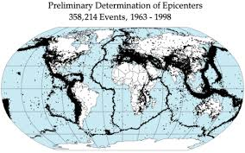
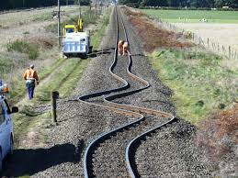
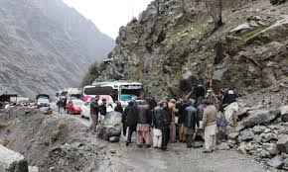
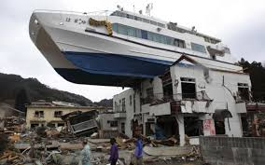
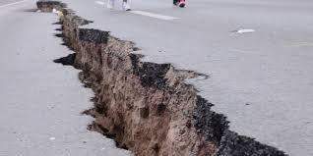
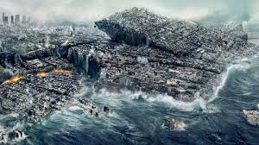
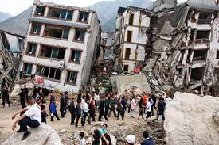
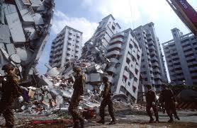
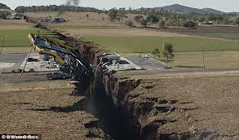
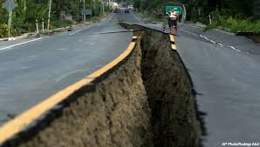
Earthquakes - Most deadly natural disaster worldwide

Slide 6
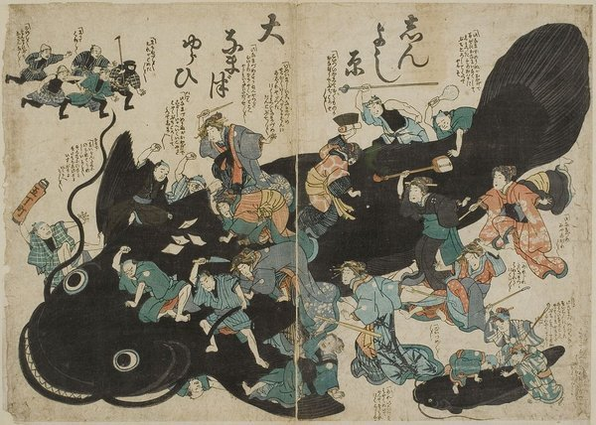
Why do earthquakes occur?

Slide 7
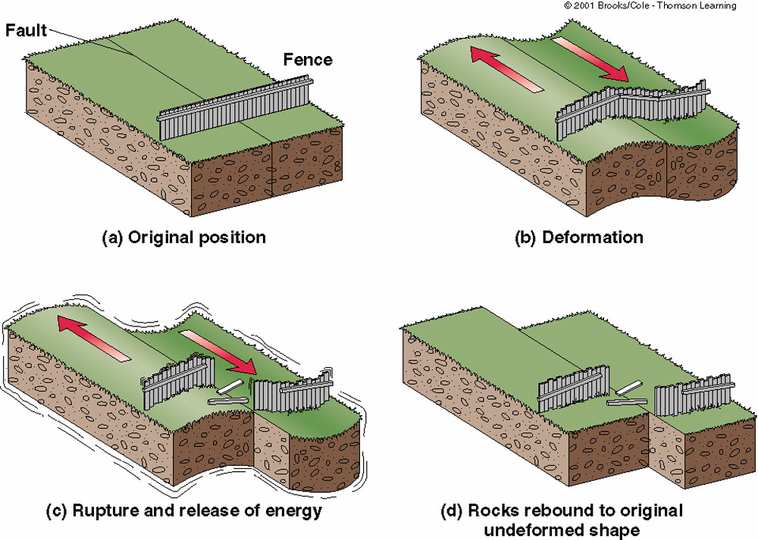
Seismic cycle – Reid’s theory (Reid, 1910)

Slide 8
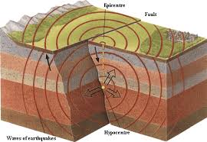
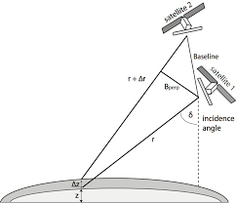
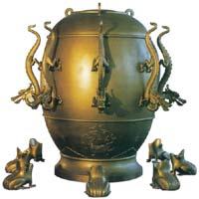
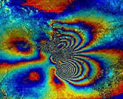
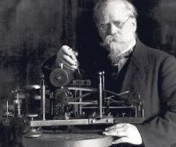
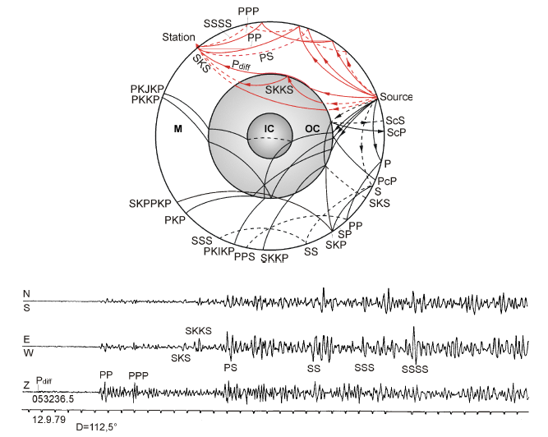
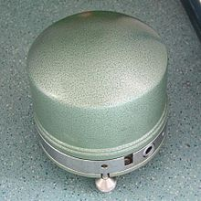
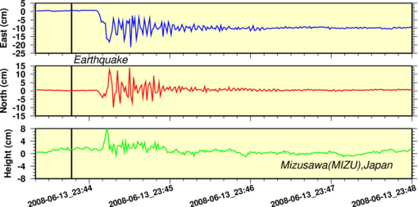
Seismic waves and near-field surface deformation
Zhang Heng (78-139 A.D.)
InSAR
Emil Wiechert (1861-1897)
STS1&2 by Erhard Wielandt (* 1940)
GPS

Slide 9
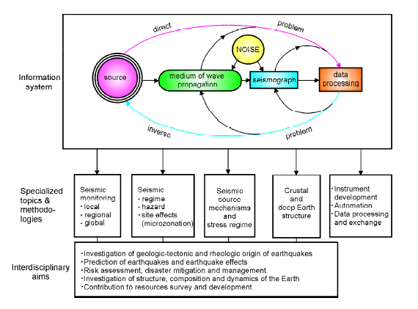
From NMSOP
(ed. Bormann, 2002)

Slide 10
Theory of earthquake deformation
Equations of motion
Spectral solution method
Propagator algorithm
Seismic sources

Slide 11
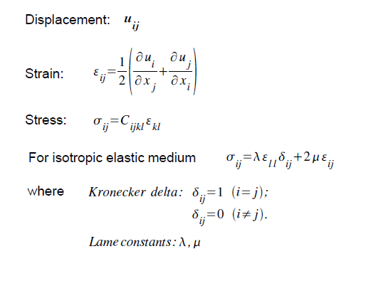
Elasticity theory

Slide 12
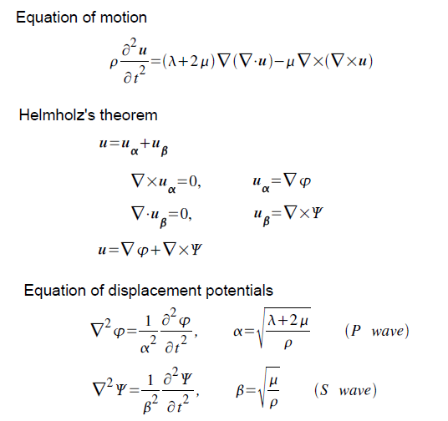

Slide 13
Boundary conditions
Stress free surface
Free surface
n = 1
h₁
2
Continuity at material interfaces
h₂
S
h_{S}
Discontinuity at source level depending on source type
N–1
h_{N–1}
N
Half-space
Convergence at infinity:

Slide 14
Theory of earthquake deformation
Equations of motion
Spectral solution method
Propagator algorithm
Seismic sources

Slide 15
Fourier (Laplace) transform
Any time series (seismograms) can be represented by an integral (summation) of harmonic oscillations over frequency
⇔

Slide 16
Hankel transform (for plane earth models)

Slide 17
Expansion into spherical harmonics (for spherical earth models)

Slide 18
Generalized displacement-stress vector
SH wave
(Toroidal mode)
Decoupled in case of lateral homogeneity
P-SV wave
(Poloidal/Spheroidal mode)

Slide 19
Partial differential equations
⇒ Ordinary differential equations
⇒ Algebraic problems
P-SV
SH

Slide 20
Eigenvalues and eigenvectors of matrix A
SH
P-SV

Slide 21
General solutions in a homogeneous medium

Slide 22
Degeneration of the P-SV solutions at static limit

Slide 23
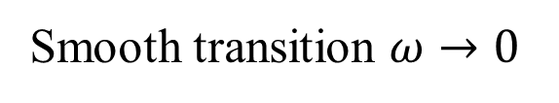
Determination of missing independent solutions
Smooth transition $ω→0$
Static P-SV layer matrix

Slide 24
Theory of earthquake deformation
Equations of motion
Spectral solution method
Propagator algorithm
Seismic sources

Slide 25
Haskell Propagator
y(z₁)
z = z₁
y(z) = L(z) E(z) c
h = z₂ – z₁
z = z₂
y(z₂)

Slide 26
Propagator algorithm for layered half-space
Starting vectors from free surface
Free surface
n = 1
h₁
2
h₂
S
h_{S}
N–1
h_{N–1}
N
Half-space
Starting vectors from bottom

Slide 27
Propagator algorithm for layered half-space
Surface (stress free)
Free surface
n = 1
h₁
2
h₂
S
Source conditions
h_{S}
(6 equations for 6 unknowns)
N–1
h_{N–1}
N
Half-space
Bottom (no upgoing waves)

Slide 28
Theory of earthquake deformation
Equations of motion
Spectral solution method
Propagator algorithm
Seismic sources

Slide 29
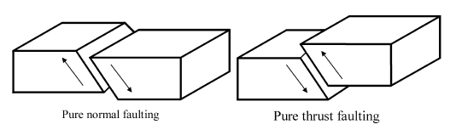
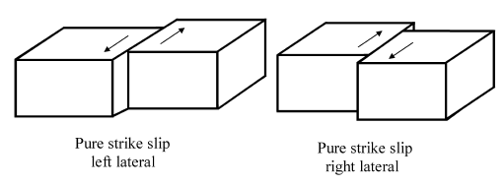
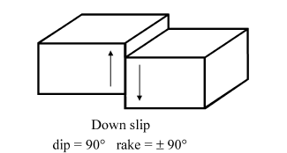
Basic types of earthquake faulting

Slide 30
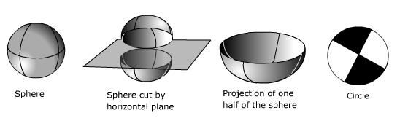
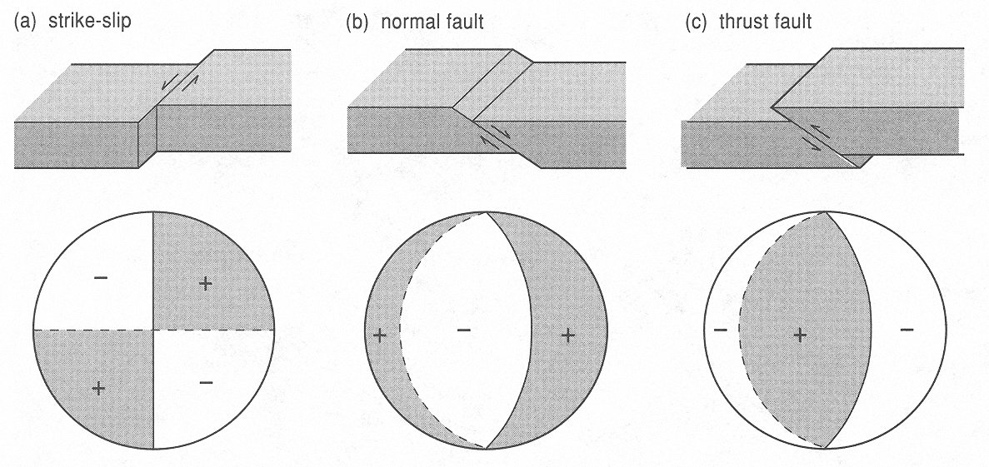
“Beachball” representation of fault mechanism

Slide 31
Description of a rectangular fault plane
Strike azimuth φ∈ (0º-360º) of fault trace
Dip angle δ∈ (0º-90º) of fault plane to horizontal plane
Slip (or Rake) angle λ∈ (0º-360º) of hanging
plate relative to foot plate
Fault size:
Length (along strike)
Width (along dip)

Slide 32
Moment tensor of a point double-couple dislocation
(Note: Seismological convention of local Cartesian coordinate system)

Slide 33
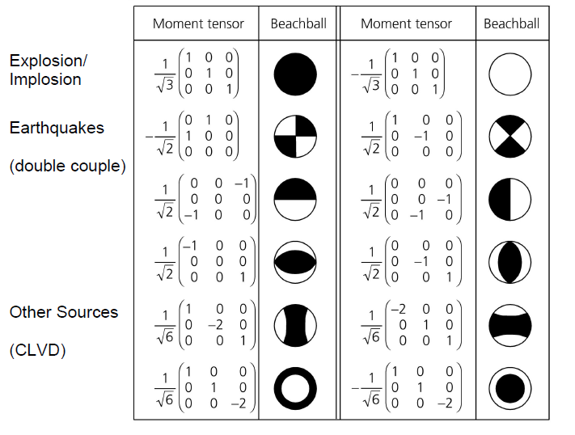
Selected moment tensor and their focal mechanisms

Slide 34
Hankel transformed single-force and double-couple sources

Slide 35
Green’s function approach
Discretize the finite fault to point dislocation sources
Decomposite each point source to fundamental double-couple sources
Calculate frequency-wavenumber-domain Green’s functions (response to fundamental DCs) using the propagator algorithm
Obtain time-space-domain Green’s functions through inverse Fourier-Hankel transform
Get synthetic seismograms of the earthquake by convolving the discrete sources with Green’s functions

Slide 36
Numerical problems and solutions
Loss-of-precision problem and orthonormalization of Haskell propagator
Time-domain aliasing and Laplace transform instead of Fourier transform
Space-domain aliasing and the differential transform

Slide 37
The case of evanescent waves
⇒ The well-known loss-of-precision problem arises because of finite computational accuracy.

Slide 38
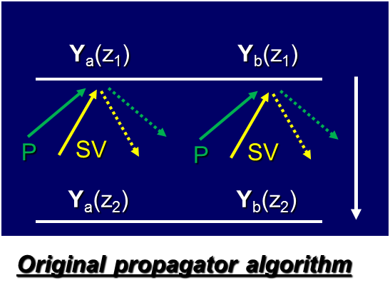
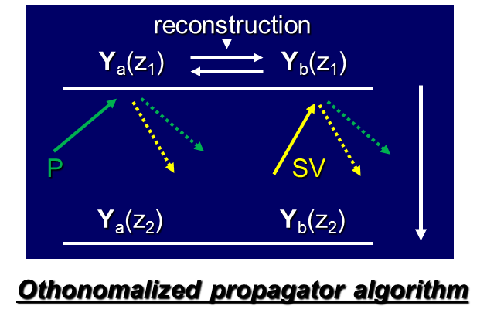
Original Haskell vs. orthonormalized propagator
Note: Loss-of-precision is caused by operation between the two incident P and SV waves rather than between the incident and reflected waves. The evidence is that no loss-of-precision problem appears when calculating the SH waves (toroidal modes).
References: Wang (1999, BSSA), Wang & Kümpel (2003, Geophysics)

Slide 39
Propagator algorithm for P-SV waves
Starting vectors from free surface
Free surface
n = 1
h₁
2
h₂
S
h_{S}
Source conditions
N–1
h_{N–1}
N
Half-space
Starting vectors from bottom

Slide 40
General form of starting vectors
Two independent starting vectors at surface
Source:
Two independent starting vectors from bottom

Slide 41
Idea of orthonormalized propagator algorithm
Scale the two starting vectors to avoid possible numerical overflow during propagation through a homogeneous layer
⇒ normalization
Choose or reconstruct the two starting vectors to avoid any operation between the incident P and SV waves during propagation through a homogeneous layer
⇒ orthogonalization

Slide 42
Technical details of orthonormalization
For upward propagation,

Slide 43
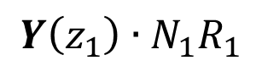
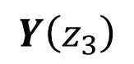
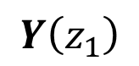
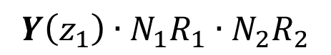
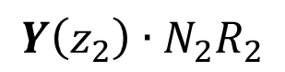
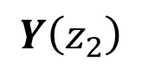
Orthonormalized propagator algorithm for a stack of layers
$$Y\left(z_{1}\right)$$
$$Y\left(z_{1}\right)∙N_{1}R_{1}$$
$$Y\left(z_{1}\right)∙N_{1}R_{1}∙N_{2}R_{2}$$
$$Y\left(z_{2}\right)$$
$$Y\left(z_{2}\right)∙N_{2}R_{2}$$
$$Y\left(z_{3}\right)$$
Simultaneous orthonormalization of all past interface vectors!

Slide 44
Numerical problems and solutions
Loss-of-precision problem and orthonormalization of Haskell propagator
Time-domain aliasing and Laplace transform instead of Fourier transform
Space-domain aliasing and the differential transform

Slide 45
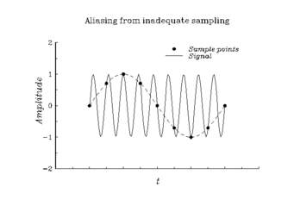
Sampling rule of discrete Fourier transform
FFT:
⇒ See Nyquist theorem.

Slide 46
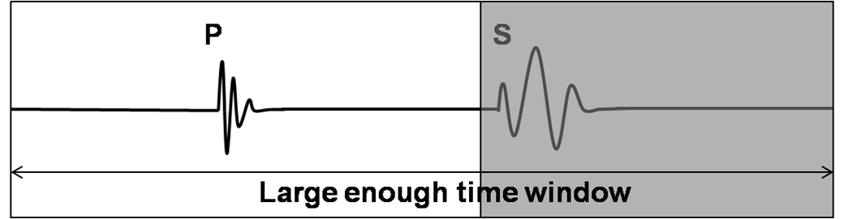
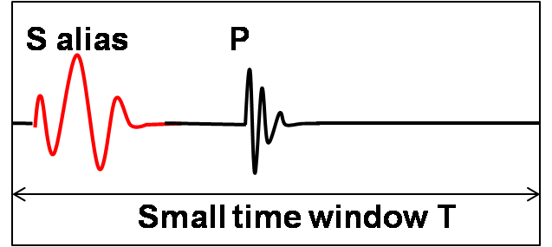
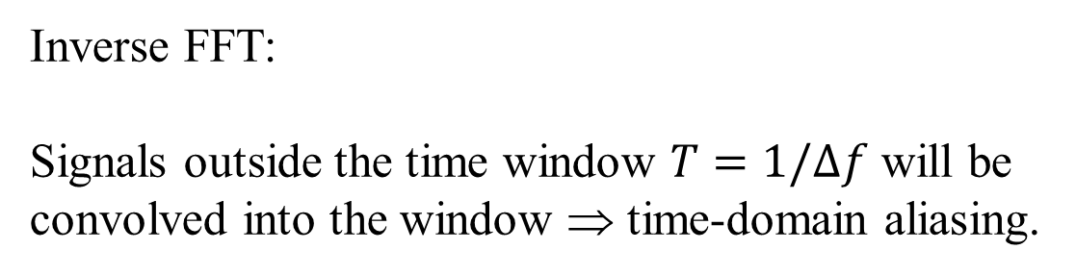
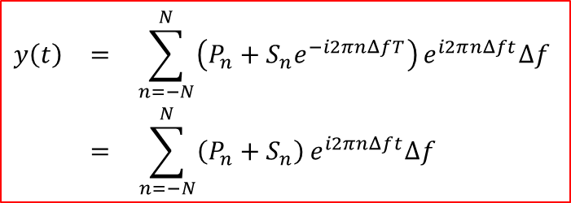
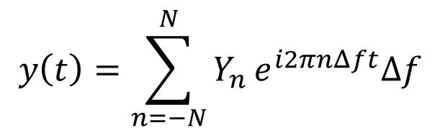
Time-domain aliasing in synthetic seismograms
$$y\left(t\right)=\sum_{n=−N}^{N}{Y_{n}}e^{i2πnΔft}Δf$$
Inverse FFT:
Signals outside the time window $T=1/Δf$ will be convolved into the window ⇒ time-domain aliasing.
T
$$\begin{matrix}y\left(t\right) & = & \sum_{n=−N}^{N}{\left(P_{n}+S_{n}e^{−i2πnΔfT}\right)}e^{i2πnΔft}Δf \\ & = & \sum_{n=−N}^{N}{\left(P_{n}+S_{n}\right)}e^{i2πnΔft}Δf \end{matrix}$$

Slide 47
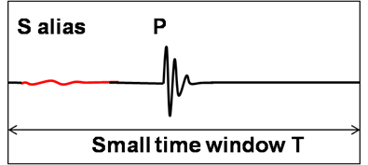
Anti time-domain aliasing
The aliasing phase is suppressed by factor e^{-σT}.
(Choose σ not necessarily too large!)

Slide 48
Numerical problems and solutions
Loss-of-precision problem and orthonormalization of Haskell propagator
Time-domain aliasing and Laplace transform instead of Fourier transform
Space-domain aliasing and the differential transform

Slide 49
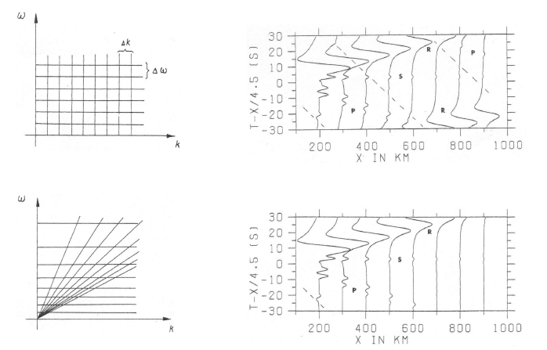
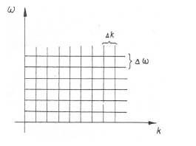
Equidistant k sampling vs. equidistant s sampling
ω
Δs
Δω
S=k/ω

Slide 50
Space-domain aliasing caused by sharp slowness cutoff
W(s)
Fast waves Slow waves
1
0
s = k/ω
s₁ s₂ s₃ s₄
Slowness filter

Slide 51
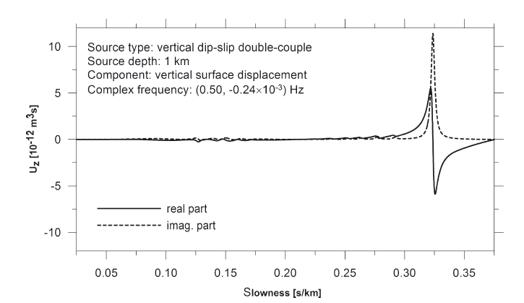
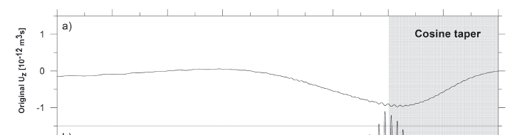
Example for teleseismic Hankel spectra of shallow source
P
S
Rayleigh
P

Slide 52
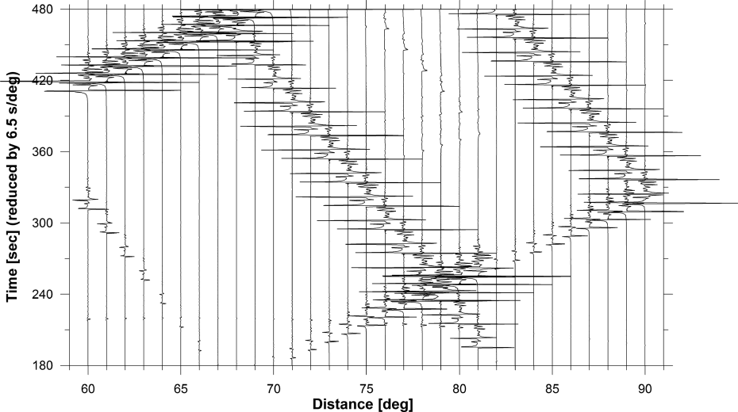
Example for numerical phases
Shallow source
Sharp slowness cutoff
Anti space-domain aliasing similarly to anti time-domain aliasing?

Slide 53

Reminder: Anti time-domain aliasing
⇒ The aliasing phase is suppressed by factor e^{-σT}.

Slide 54
Differential transform of Hankel spectrum
Suppress near field
& amplify far field
Wang & Wang (2007, GJI)

Slide 55


Differential transform of spherical harmonics
$$f\left(θ\right)=\sum_{l=m}^{∞}{F_{l}P_{l}^{m}\left(cosθ\right), \left(m≥0\right)},$$
$$2\sin^{2}\left(\frac{θ}{2}\right)∙f\left(θ\right)=\sum_{l=m}^{∞}{G_{l}P_{l}^{m}\left(cosθ\right)}.$$
$$G_{l}=F_{l}−\frac{l+m+1}{2l+3}F_{l+1}−\frac{l−m}{2l−3}F_{l−1}$$
$$G_{l}≈F_{l}−{\left(F_{l+1}+F_{l−1}\right)}/2$$
$=−∆^{2}F_{l}/2$, for large $l$.
Suppress near field
& amplify far field
$$f\left(θ\right)=\frac{1}{2\sin^{2}\left(\frac{θ}{2}\right)}\sum_{l=m}^{∞}{G_{l}P_{l}^{m}\left(cosθ\right)}$$
Wang & Wang (2007, GJI)

Slide 56

Hankel spectrum after differential transform

Slide 57

Improvement by using 1. order differential transform

Slide 58

Improvement by using 2. order differential transform

Slide 59
EDGRN/EDCMP - Computation of coseismic static deformation
Green’s function approach
Analytical Okada’s solutions based on a homogeneous halfspace model
Layering effect
Exercises with EDGRN/EDCMP

Slide 60



Green’s function approach
Discrete fault slip
Convolution of Green’s function with slip distribution
$$u\left(x\right)=\iint{G\left(x,x_{o}\right)∙ΔU\left(x_{o}\right)ds}$$
A Green's function is the impulse response of an inhomogeneous differential equation defined on a domain, with specified initial conditions or boundary conditions.
Here Green's function $G\left(x,x_{o}\right)$ is the contribution to the observable $u$ (e.g., displacement) at station $x$produced by a unit slip of the fault patch at $x_{o}$.

Slide 61
Computation of Green’s functions
In case of a general 3D earth structure, a static Green’s function depends on
Observable (displacement vector, strain/stress tensor, …)
Source mechanism (strike-slip, dip-slip, CLVD, inflation)
Observation site (3D)
Source location (3D)
⇒ N files each including 6D data!
In case of a laterally homogeneous 1D earth structure, a static Green’s function depends on
Observable (displacement vector, strain/stress tensor, …)
Source mechanism (strike-slip, dip-slip, CLVD, inflation)
Observation depth (1D)
Source depth (1D)
Horizontal distance and azimuth of the observation site relative to source (2D)
⇒ N files each including 4D data!

Slide 62
EDGRN/EDCMP - Computation of coseismic static deformation
Green’s function approach
Analytical Okada’s solutions based on a homogeneous halfspace model
Layering effect
Exercises with EDGRN/EDCMP

Slide 63



Analytical Okada’s solutions
Response of an elastic half-space to a point or rectangular dislocation source
-
Simple and most used because of their analytical closed form
All formulae are given in
Okada, Y., 1992. Internal deformation due to shear and tensile faults in a half-space. Bulletin of the Seismological Society of America 82, 1018–1040.
Program code is free available in the form of FORTRAN subroutine.

Slide 64
EDGRN/EDCMP - Computation of coseismic static deformation
Green’s function approach
Analytical Okada’s solutions based on a homogeneous halfspace model
Layering effect
Exercises with EDGRN/EDCMP

Slide 65


Layering effect
Neglecting the effect of the layered earth structure
may affect the accuracy of Green’s functions by up to 10-20%
Leading to underestimate of the source depth from geodetic data

Slide 66


Semi-analytical solutions
Response of a multi-layered elastic half-space to a finite dislocation source
Wang, R., Lorenzo Martin, F., Roth, F., 2003. Computation of deformation induced by earthquakes in a multi-layered elastic crust - FORTRAN programs EDGRN / EDCMP. Computers and Geosciences 29 (2), 195-207.

Slide 67
EDGRN/EDCMP - Computation of coseismic static deformation
Green’s function approach
Analytical Okada’s solutions based on a homogeneous halfspace model
Layering effect
Exercises with EDGRN/EDCMP

Slide 68
Input of EDGRN

Slide 69
Input of EDGRN
#==============================================================
# This is the input file of FORTRAN77 program "edgrn" for calculating
# the Green's functions of a layered elastic half-space earth model. All
# results will be stored in the given directory and provide the necessary
# data base for the program "edcmp" for computing elastic deformations
# (3 displacement components, 6 strain/stress components and 2 vertical tilt
# components) induced by a general dislocation source.
#
# For questions please contact with e-mail to "wang@gfz-potsdam.de".
#
# First implemented in May, 1997
# Last modified: Nov, 2001
#
# by Rongjiang Wang
# GeoForschungsZetrum Potsdam, Telegrafenberg, 14473 Potsdam, Germany
#
# For questions and suggestions please send e-mails to wang@gfz-potsdam.de
#
#------------------------------------------------------------------------------
#
#PARAMETERS FOR THE OBSERVATION PROFILE
#======================================
# 1. the uniform depth of the observation points [m]
# 2. number of the equidistant radial distances (max. = nrmax in edgglobal.h),
# the start and end of the distances [m]
# 3. number of the equidistant source depths (max. = nzsmax in edgglobal.h),
# the start and end of the source depths [m]
#
# If possible, please choose the observation depth either significantly
# different from the source depths or identical with one of them.
#
# The 2D distance and depth grids defined here should be necessarily large
# and dense enough for the discretisation of the real source-observation
# configuration to be considered later.
#
# r1,r2 = minimum and maximum horizontal source-observation distances
# z1,z2 = minimum and maximum source depths
#
#------------------------------------------------------------------------------
0.00d+00 |dble: obs_depth;
501 0.00d+00 1000.00d+03 |int: nr; dble: r1, r2;
201 0.00d+00 40.00d+03 |int: nzs; dble: zs1, zs2;
#------------------------------------------------------------------------------
#
#
#WAVENUMBER INTEGRATION PARAMETERS
#=================================
# 1. sampling rate for wavenumber integration (the ratio between the Nyquist
# wavenumber and the really used wavenumber sample; the suggested value is
# 10-128: the larger this value is chosen, the more accurate are the results
# but also the more computation time will be required)
#------------------------------------------------------------------------------
12.0 |dble: srate;
#------------------------------------------------------------------------------
#
#OUTPUT FILES
#============
#
# 1. output directory, the three file names for fundamental Green's functions
# Note that all file or directory names should not be longer than 80
# characters. Directories must be ended by / (unix) or \ (dos)!
#------------------------------------------------------------------------------
'./edgrnfcts/' 'izmhs.ss' 'izmhs.ds' 'izmhs.cl' |char: outputs,grnfile(3);
#------------------------------------------------------------------------------
#
#MULTILAYERED MODEL PARAMETERS
#=============================
# The interfaces at which the elastic parameters are continuous, the surface
# and the upper boundary of the half-space are all defined by a single data
# line; The interfaces, at which the elastic parameters are discontinuous,
# are all defined by two data lines. This input format would also be needed for
# a graphic plot of the layered model.
#
# Layers which have different upper and lower parameter values, will be treated
# as layers with a constant gradient, and will be discretised by a number of
# homogeneous sublayers. Errors due to the discretisation are limited within
# about 5%.
#
# 1. total number of the data lines (max. = lmax in edgglobal.h)
# 2. table for the layered model
#------------------------------------------------------------------------------
3 |int: no_model_lines;
#------------------------------------------------------------------------------
# no depth[m] vp[m/s] vs[m/s] ro[kg/m^3]
#------------------------------------------------------------------------------
1 0.000d+00 4.5000d+03 2.4000d+03 2.7000d+03
2 1.000d+03 4.5000d+03 2.4000d+03 2.7000d+03
3 1.000d+03 5.6000d+03 3.3000d+03 2.7000d+03
#=======================end of input================================

Slide 70
…

Slide 71
QSEIS – Computation of synthetic seismograms based on a stratified plane earth model
Earth flattening transform
Various partial solution filters (options)
Different source and receiver site structures
Exercises

Slide 72
History and special features of QSEIS
First implementation 1999, current version QSEIS2006
Orthonormalized propagator algorithm (equivalent stability as minor matrix and reflectivity methods, but simpler and more efficient)
Earth flattening transformation
Anti time-domain aliasing
Anti space-domain aliasing
Various partial solution filters
Different source and receiver site structures
Broad-band seismograms including static offsets
…

Slide 73
Earth flattening transformation
Homogeneous
Half-space
Homogeneous
sphere
Same travel time and amplitude
Same travel time and amplitude
Müller’s EFT (Müller 1985) ⇒
Half-space
with
equivalent gradient

Slide 74

Müller’s earth flattening transformation

Slide 75


Accuracy of Müller’s earth flattening transformation

Slide 76

IASP91 earth’s reference model – after EFT

Slide 77

Comparison with spherical model results

Slide 78
QSEIS – Computation of synthetic seismograms based on a stratified plane earth model
Earth flattening transform
Various partial solution filters (options)
Different source and receiver site structures
Exercises

Slide 79
Filter wave phases with shallow penetration depth
A
B
(A−B) instead of A ⇒ shallow-path filter

Slide 80
Filter free surface reflection
Option 1
With free surface
Option 2
Without free surface (the first layer medium is extended to the whole upper half-space)
Option 3
Without free surface but with correction on amplitude and waveform

Slide 81
Other phase filters
All sub-phases associated to an upgoing or downgoing P or S wave in an arbitrarily selected depth range can be filtered
⇒
Useful for phase identifications

Slide 82
QSEIS – Computation of synthetic seismograms based on a stratified plane earth model
Earth flattening transform
Various partial solution filters (options)
Different source and receiver site structures
Exercises

Slide 83



Different source and receiver site structures
$$Z_{s}$$
Source-site crust
Receiver-site crust
$$Z_{m}$$
Uniform mantle structure
Only for teleseismic distances
and only for deep body wave phases!
$$Z_{s}<Z_{m}$$

Slide 84
QSEIS – Computation of synthetic seismograms based on a stratified plane earth model
Earth flattening transform
Various partial solution filters (options)
Different source and receiver site structures
Exercises

Slide 85
Input parameters of QSEIS2006
Source parameters
- (uniform) source depth
Receiver parameters
- (uniform) receiver depth
- distance sampling
- time sampling
Slowness integration
- slowness window
- integration accuracy
- anti-space-domain-aliasing
- anti-time-domain-aliasing
Partial solution options
- surface reflection filter
- shallow path filter
- wave phase filter
Source time function
- source duration
- wavelet
Instrument filter
- amplification factor
- zeros
- poles
Output files
- Green’s functions
- general point source
Earth model
- earth flattening transformation
- gradient resolution
- (source-site) earth model
- receiver-site crust model

Slide 86
Exercises
Crust model
Partial solutions
Surface waves
Anti time-domain aliasing
Head wave
Teleseismic distances
Teleseismic distances with small slowness
- designed by Xiaohui Yuan (2005)

Slide 87


Exercise 1 – Crust model

Slide 88

Exercise 2 – Partial solutions

Slide 89


Exercise 3 – Surface waves

Slide 90


Exercise 4 – Anti time-domain aliasing

Slide 91


Exercise 5 – Head wave

Slide 92


Exercise 6 – Teleseismic distances
t – Δ∗6.5 (s)

Slide 93


Exercise 7 – Teleseismic distances with small slowness
t – Δ∗6.5 (s)

Slide 94
QSSP – Computation of complete synthetic seismograms based on a self-gravitating earth model with the atmosphere-ocean-mantle-core structure
Normal mode theory, effect of gravity and self-gravitation
Hybrid algorithm
Examples of complete seismograms: body waves, surface waves, infrasound gravity waves, tsunami, circling surface waves and free oscillations, static offsets, etc.

Slide 95

Equations of motion
governing deformation in
a spherically symmetric, elastic and self-gravitating earth
$$\left\{\begin{matrix}ρ\frac{∂u}{{∂t}^{2}} & = & ∇∙σ+ρ∇\left(ψ−gu_{r}\right)+ρg\left(∇∙u\right)e_{r}+f, \\ ∇^{2}ψ & = & 4πG∇∙\left(ρu\right). \end{matrix}\right.$$
$ρ=$ density, $σ=$ stress tensor, $G=$ gravitational constant,
$f=$ body force (seismic source), $u=$ displacement vector,
$ψ=$ deformation-induced gravity potential change,
$g=$ gravity (downwards positive), $g\left(r\right)= \frac{4πG}{r^{2}}\int_{0}^{r}{ρ\left(ξ\right)ξ^{2}dξ}$.
$σ= λ\left(∇∙u\right)I+μ\left[∇u+{\left(∇u\right)}^{T}\right]$ (Hooke’s law)

Slide 96



Boundary conditions
At earth’s surface:
$$\left\{\begin{aligned}{\left.e_{r}∙σ\right|}_{r=a}=0\text{,} \\ {\left.e_{r}∙\left(∇ψ−4πGρu\right)\right|}_{r=a}^{}=0 \end{aligned}\right.$$
At earth’s interior interface:
$$\left\{\begin{matrix}{\left.u\right|}_{− }^{+}=0 \left({\left.u_{n}\right|}_{− }^{+}=0, fluid\right), \\ {\left.e_{r}∙σ\right|}_{− }^{+}=0, \\ {\left.ψ\right|}_{− }^{+}=0, \\ {\left.e_{r}∙\left(∇ψ−4πGρu\right)\right|}_{− }^{+}=0, \end{matrix}\right.$$
At earth’s center of mass:
$$\left\{\begin{matrix} {\left.u\right|}_{r→0}=0, \\ {\left.e_{r}∙∇ψ\right|}_{r→0}=0.\end{matrix} \right.$$

Slide 97
Solution strategy of spectral method
Equations of motion in time-space domain
(4 PDE of 2. order)
Fourier transform
&
Expansion in spherical harmonics
Spectral Method
Equations of motion in frequency-wavenumber domain
(8 ODE of 1. order)
Haskell propagator
Runge-Kutta integration

Slide 98


Expansion in terms of spherical harmonics
$$\left\{\begin{matrix}u=\sum_{l=0}^{∞}{\sum_{m=−l}^{l}{\left[U_{l}^{m}\left(r\right)R_{l}^{m}\left(θ,φ\right)+V_{l}^{m}\left(r\right)S_{l}^{m}\left(θ,φ\right)+W_{l}^{m}\left(r\right)T_{l}^{m}\left(θ,φ\right)\right]}}, \\ ψ=\sum_{l=0}^{∞}{\sum_{m=−l}^{l}{Φ_{l}^{m}\left(r\right)Y_{l}^{m}\left(θ,φ\right)}}, \\ e_{r}∙σ=\sum_{l=0}^{∞}{\sum_{m=−l}^{l}{\left[E_{l}^{m}\left(r\right)R_{l}^{m}\left(θ,φ\right)+F_{l}^{m}\left(r\right)S_{l}^{m}\left(θ,φ\right)+G_{l}^{m}\left(r\right)T_{l}^{m}\left(θ,φ\right)\right].}}\end{matrix}\right.$$
$$\left\{\begin{matrix}R_{l}^{m}\left(θ,φ\right)=e_{r}Y_{l}^{m}\left(θ,φ\right), \\ S_{l}^{m}\left(θ,φ\right)=e_{θ}\frac{∂}{∂θ}Y_{l}^{m}\left(θ,φ\right)+e_{φ}\frac{1}{sinθ}\frac{∂}{∂φ}Y_{l}^{m}\left(θ,φ\right), \\ T_{l}^{m}\left(θ,φ\right)=e_{θ}\frac{1}{sinθ}\frac{∂}{∂φ}Y_{l}^{m}\left(θ,φ\right)−e_{φ}\frac{∂}{∂θ}Y_{l}^{m}\left(θ,φ\right),\end{matrix}\right.$$
$Y_{l}^{m}\left(θ,φ\right)=P_{l}^{\left|m\right|}\left(cosθ\right)e^{imφ}.$

Slide 99



Ordinary differential equations of motion for toroidal modes
$$X={\left(W_{l}^{m},G_{l}^{m}\right)}^{T}$$
$$\frac{d}{dr}X=A∙X$$
Meaningless for $l=0$per definition.
$$\left\{\begin{matrix}{\dot{X}}_{1}=\frac{1}{r}X_{1}+\frac{1}{μ}X_{2}, \\ {\dot{X}}_{2}=\left[− ρω^{2}+\frac{\left(l−1\right)\left(l+2\right)μ}{r^{2}}\right]X_{1}−\frac{3}{r}X_{2}.\end{matrix}\right.$$

Slide 100


Ordinary differential equations of motion for spheroidal modes
$$Y={\left(U_{l}^{m},E_{l}^{m},V_{l}^{m},F_{l}^{m},Φ_{l}^{m},{\dot{Φ}}_{l}^{m}+\frac{l+1}{r}Φ_{l}^{m}−4πGρU_{l}^{m}\right)}^{T}$$
$$\left\{\begin{matrix}{\dot{Y}}_{1}=−\frac{2λ}{\left(λ+2μ\right)r}Y_{1}+\frac{1}{λ+2μ}Y_{2}+\frac{l\left(l+1\right)λ}{\left(λ+2μ\right)r}Y_{3}, \\ {\dot{Y}}_{2}=\left[−ρω^{2}−\frac{4ρg}{r}+\frac{4μ\left(3λ+2μ\right)}{\left(λ+2μ\right)r^{2}}\right]Y_{1}−\frac{4μ}{\left(λ+2μ\right)r}Y_{2}, \\ +l\left(l+1\right)\left[\frac{ρg}{r}−\frac{2μ\left(3λ+2μ\right)}{\left(λ+2μ\right)r^{2}}\right]Y_{3}+\frac{l\left(l+1\right)}{r}Y_{4}+\frac{\left(l+1\right)ρ}{r}Y_{5}−ρY_{6}, \\ {\dot{Y}}_{3}=−\frac{1}{r}Y_{1}+\frac{1}{r}Y_{3}+\frac{1}{μ}Y_{4}, \\ {\dot{Y}}_{4}=\left[\frac{ρg}{r}−\frac{2μ\left(3λ+2μ\right)}{\left(λ+2μ\right)r^{2}}\right]Y_{1}−\frac{λ}{\left(λ+2μ\right)r}Y_{2} \\ +\left\{−ρω^{2}+\frac{2μ}{r^{2}}\left[\frac{2l\left(l+1\right)\left(λ+μ\right)}{λ+2μ}−1\right]\right\}Y_{3}−\frac{3}{r}Y_{4}−\frac{ρ}{r}Y_{5}, \\ {\dot{Y}}_{5}=4πGρY_{1}−\frac{l+1}{r}Y_{5}+Y_{6}, \\ {\dot{Y}}_{6}=\frac{4πGρ\left(l+1\right)}{r}Y_{1}−\frac{4πGρl\left(l+1\right)}{r}Y_{3}+\frac{l−1}{r}Y_{6}. \end{matrix} \right.$$

Slide 101


Special case 1: $l=0$
$$Y_{3}=0, Y_{4}=0, Y_{6}=\frac{Y_{5}}{r}.$$
$$\left\{\begin{matrix}{\dot{Y}}_{1}=−\frac{2λ}{\left(λ+2μ\right)r}Y_{1}+\frac{1}{λ+2μ}Y_{2}, \\ {\dot{Y}}_{2}=\left[−ρω^{2}−\frac{4ρg}{r}+\frac{4μ\left(3λ+2μ\right)}{\left(λ+2μ\right)r^{2}}\right]Y_{1}−\frac{4μ}{\left(λ+2μ\right)r}Y_{2}, \\ {\dot{Y}}_{5}=4πGρY_{1}. \end{matrix}\right.$$

Slide 102



Special case 2: $μ=0$ (fluid)
$$\begin{matrix}Y_{4}=0, \\ ρgY_{1}−Y_{2}−ρω^{2}rY_{3}−ρY_{5}=0.\end{matrix}$$
$$\left\{\begin{matrix}{\dot{Y}}_{1}=−\frac{2}{r}Y_{1}+\frac{1}{λ}Y_{2}+\frac{l\left(l+1\right)}{r}Y_{3}, \\ {\dot{Y}}_{2}=−\left(ρω^{2}+\frac{4ρg}{r}\right)Y_{1}+ \frac{l\left(l+1\right)ρg}{r}Y_{3}+\frac{\left(l+1\right)ρ}{r}Y_{5}−ρY_{6}, \\ {\dot{Y}}_{5}=4πGρY_{1}−\frac{l+1}{r}Y_{5}+Y_{6}, \\ {\dot{Y}}_{6}=\frac{4πGρ\left(l+1\right)}{r}Y_{1}−\frac{4πGρl\left(l+1\right)}{r}Y_{3}+\frac{l−1}{r}Y_{6}. \end{matrix}\right.$$
Unstable when $ω→0$!

Slide 103





Reformulation of spheroidal modes for $μ=0$
Differentiate the equation
$$ρgY_{1}−Y_{2}−ρω^{2}rY_{3}−ρY_{5}=0$$
$$\left\{\begin{matrix}{\dot{Y}}_{1}=\left(\frac{ρg}{λ}−\frac{2}{r}\right)Y_{1}+\left[\frac{l\left(l+1\right)}{r}−\frac{ρω^{2}r}{λ}\right]Y_{3}−\frac{ρ}{λ}Y_{5}, \\ {\dot{Y}}_{3}=\frac{1}{r}\left(1−\frac{N^{2}}{ω^{2}}\right)Y_{1}−\frac{1}{r}\left(1−\frac{N^{2}r}{g}\right)Y_{3}+\frac{N^{2}}{ω^{2}gr}Y_{5}, \\ {\dot{Y}}_{5}=4πGρY_{1}−\frac{l+1}{r}Y_{5}+Y_{6}, \\ {\dot{Y}}_{6}=\frac{4πGρ\left(l+1\right)}{r}Y_{1}−\frac{4πGρl\left(l+1\right)}{r}Y_{3}+\frac{l−1}{r}Y_{6},\end{matrix}\right.$$
Outer core:
$\frac{N^{2}}{2π}\sim$0
Atmosphere:
$\frac{N^{2}}{2π}\sim$1.75-3.68 mHz.
$N^{2}/2π$ is Brunt-Väisälä frequency
$<0$: unstable
$=0$: stable (Adam-Williamson condition)
$>0$: super stable
$$N^{2}=−\frac{g}{ρ}\left(\frac{dρ}{dr}+\frac{ρ^{2}g}{λ}\right)$$

Slide 104
QSSP – Computation of complete synthetic seismograms based on a self-gravitating earth model with the atmosphere-ocean-mantle-core structure
Normal mode theory, effect of gravity and self-gravitation
Hybrid algorithm
Examples of complete seismograms: body waves, surface waves, infrasound gravity waves, tsunami, circling surface waves and free oscillations, static offsets, etc.

Slide 105


With or without the gravity effect?
Without gravity:
Analytical closed-form solutions ⇒ propagator algorithm, but
No tsunami wave
No infrasound gravity wave
Wrong spectra of low-frequency spheroidal free oscillations
With gravity:
Analytical closed-form solutions only for outer and inner core, where $g\left(r\right)∝r.$
Hybrid algorithm
Numerical Runge-Kutta integration for fully gravity-deformation coupling in the range $f≤3 mHz$ and $l≤300$, else analytical propagator algorithm without gravity effect on deformation

Slide 106



Frequency-degree integration/summation area
$$l=2πaf∙s_{min}$$
$$l=2πaf∙s_{max}$$

Slide 107

Numerical solutions by orthonormalized R-K integration
Normalization:
$$y_{i}\left(r_{n}\right)≔\frac{y_{i}\left(r_{n}\right)}{\left\|y_{i}\left(r_{n}\right)\right\|}, i=1,2,3.$$
Orthogonalization:
$y_{1}\left(r_{n}\right)≔$ $y_{1}\left(r_{n}\right),$
$$y_{2}\left(r_{n}\right)≔y_{2}\left(r_{n}\right)+ay_{1}\left(r_{n}\right), ←y_{2}\left(r_{n}\right)⊥y_{1}\left(r_{n}\right),$$
$$y_{3}\left(r_{n}\right)≔y_{3}\left(r_{n}\right)+by_{1}\left(r_{n}\right)+cy_{2}\left(r_{n}\right), ←\left\{\begin{matrix}y_{3}\left(r_{n}\right)⊥y_{1}\left(r_{n}\right), \\ y_{3}\left(r_{n}\right)⊥y_{2}\left(r_{n}\right)\text{. }\end{matrix}\right.$$
Integration from $r_{n}$ to $r_{n+1}$, …

Slide 108


Analytical solutions for a homogeneous spherical shell
Analytical closed-form solutions for the toroidal mode were derived by Gilbert & Backus (1968).
Analytical closed-form solutions for the spheroidal mode were derived by Gilbert & Backus (1968), too, but by assuming that $g\left(r\right)/r=const$.
Complete analytical closed-form solutions for both toroidal and non-gravitating spheroidal modes are given by Takeuchi & Saito (1972).
Expansion of seismic sources in terms spherical harmonics also see Takeuchi & Saito (1972).
Assumption on analytical solutions used in QSSP
Deformation and gravity change are coupled hierarchically, i.e., deformation is independent from gravity and self-gravitation, while gravity change is induced purely by deformation.
$$\left\{\begin{matrix}ρ\frac{∂u}{{∂t}^{2}} & = & ∇∙σ+f, \\ ∇^{2}ψ & = & 4πG∇∙\left(ρu\right). \end{matrix}\right.$$

Slide 109






Two fundamental solutions of toroidal mode
$$\left\{\begin{matrix}X_{11}=j_{l}\left(x_{s}\right), \\ rX_{21}=μ\left[\left(l−1\right)j_{l}\left(x_{s}\right)−x_{s}j_{l+1}\left(x_{s}\right)\right],\end{matrix}\right.$$
$$\left\{\begin{matrix}X_{12}=y_{l}\left(x_{s}\right), \\ rX_{22}=μ\left[\left(l−1\right)y_{l}\left(x_{s}\right)−x_{s}y_{l+1}\left(x_{s}\right)\right],\end{matrix}\right.$$
Regular at $r→0$
Irregular at$r→0$
$\begin{matrix}x_{s}=k_{s}r\end{matrix}$, $k_{s}=\frac{ω}{V_{s}}$.
$j_{l}\left(x\right)$ and $y_{l}\left(x\right)$ are the spherical Bessel functions of 1. and 2. kind, respectively.
$$\left\{\begin{matrix}\begin{aligned}j_{0}\left(x\right)=\frac{\sin{x}}{x} \\ \end{aligned} \\ y_{0}\left(x\right)=\frac{\cos{x}}{x }\end{matrix}\right.$$
Recursive relations
$f_{l+1}\left(x\right)=x^{l}\frac{d}{dx}\left[x^{−l}f_{l}\left(x\right)\right]$, $f_{l}=j_{l},y_{l}$

Slide 110



Fundamental solutions of spheroidal mode - 1
$$\left\{\begin{matrix}rY_{11}=lj_{l}\left(x_{p}\right)−x_{p}j_{l+1}\left(x_{p}\right), \\ r^{2}Y_{21}=−\left(λ+2μ\right)x_{p}^{2}j_{l}\left(x_{p}\right)+2μ\left[l\left(l−1\right)j_{l}\left(x_{p}\right)+2x_{p}j_{l+1}\left(x_{p}\right)\right], \\ rY_{31}=j_{l}\left(x_{p}\right), \\ r^{2}Y_{41}=2μ\left[\left(l−1\right)j_{l}\left(x_{p}\right)−x_{p}j_{l+1}\left(x_{p}\right)\right], \\ Y_{51}=4πGρj_{l}\left(x_{p}\right), \\ rY_{61}=4πGρ\left(l+1\right)j_{l}\left(x_{p}\right), \end{matrix}\right.$$
$$\begin{matrix}x_{p}=k_{p}r=\frac{ω}{V_{p}}r\end{matrix}$$
Regular at $r→0$

Slide 111


Fundamental solutions of spheroidal mode - 2
$$\left\{\begin{matrix}rY_{12}=−\left(l+1\right)y_{l}\left(x_{p}\right)+\frac{x_{p}^{2}y_{l−1}\left(x_{p}\right)}{\left(2l−1\right)}, \\ r^{2}Y_{22}=−\left(λ+2μ\right)x_{p}^{2}y_{l}\left(x_{p}\right)+2μ\left[\left(l+1\right)\left(l+2\right)y_{l}\left(x_{p}\right)−\frac{2x_{p}^{2}y_{l−1}\left(x_{p}\right)}{\left(2l−1\right)}\right], \\ rY_{32}=y_{l}\left(x_{p}\right), \\ r^{2}Y_{42}=2μ\left[−\left(l+2\right)y_{l}\left(x_{p}\right)+\frac{x_{p}^{2}y_{l−1}\left(x_{p}\right)}{\left(2l−1\right)}\right], \\ Y_{52}=4πGρy_{l}\left(x_{p}\right), \\ rY_{62}=4πGρ\left(l+1\right)y_{l}\left(x_{p}\right), \end{matrix}\right.$$
Irregular at $r→0$
$Y_{i1}$ & $Y_{i2}$ make up upgoing and downgoing P waves

Slide 112




Fundamental solutions of spheroidal mode – 3 & 4
$$\left\{\begin{matrix}rY_{13}={−l\left(l+1\right)j}_{l}\left(x_{s}\right), \\ r^{2}Y_{23}=2μl\left(l+1\right)\left[−\left(l−1\right)j_{l}\left(x_{s}\right)+x_{s}j_{l+1}\left(x_{s}\right)\right], \\ rY_{33}=−\left(l+1\right)j_{l}\left(x_{s}\right)+x_{s}j_{l+1}\left(x_{s}\right), \\ r^{2}Y_{43}=μ\left[x_{s}^{2}j_{l}\left(x_{s}\right)−2\left(l^{2}−1\right)j_{l}\left(x_{s}\right)−2x_{s}j_{l+1}\left(x_{s}\right)\right], \\ Y_{53}=0, \\ rY_{63}=4πGρl\left(l+1\right)j_{l}\left(x_{s}\right), \end{matrix}\right.$$
Regular at $r→0$
$$\left\{\begin{matrix}rY_{14}={−l\left(l+1\right)y}_{l}\left(x_{s}\right), \\ r^{2}Y_{24}=2μl\left(l+1\right)\left[−\left(l−1\right)y_{l}\left(x_{s}\right)+x_{s}y_{l+1}\left(x_{s}\right)\right], \\ rY_{34}=−\left(l+1\right)y_{l}\left(x_{s}\right)+x_{s}y_{l+1}\left(x_{s}\right), \\ r^{2}Y_{44}=μ\left[x_{s}^{2}y_{l}\left(x_{s}\right)−2\left(l^{2}−1\right)y_{l}\left(x_{s}\right)−2x_{s}y_{l+1}\left(x_{s}\right)\right]. \\ Y_{54}=0, \\ rY_{64}=4πGρl\left(l+1\right)y_{l}\left(x_{s}\right). \end{matrix}\right.$$
Irregular at $r→0$
$Y_{i3}$ & $Y_{i4}$ make up upgoing and downgoing SV waves

Slide 113





Fundamental solutions of spheroidal mode – 5 & 6
$$\left\{\begin{matrix}rY_{15}=0, \\ r^{2}Y_{25}=0, \\ rY_{35}=0, \\ r^{2}Y_{45}=0, \\ Y_{55}=r^{l}, \\ rY_{65}=\left(2l+1\right)r^{l},\end{matrix}\right.$$
$$\left\{\begin{matrix}rY_{16}=0, \\ r^{2}Y_{26}=0, \\ rY_{36}=0, \\ r^{2}Y_{46}=0, \\ Y_{56}=r^{−\left(l+1\right)}, \\ rY_{66}=0. \end{matrix}\right.$$
Regular at $r→0$
Irregular at $r→0$
$Y_{i5}$ & $Y_{i6}$ describe the state without deformation. In this case the gravity potential is harmonic.

Slide 114
Propagator algorithm for spherical models
So far, no propagator algorithm for spherical models has published and used in analogy to that for layered half-space models, though complete analytical solutions exist for both kinds of models.
Why?
The reflectivity (propagator) code has been widely used and can serve most needs for body and wave simulations.
Normal mode approach (numerical integration) has served the complementary need for solving free oscillation problems.
The propagator algorithm for spherical models is challenging because of its numerical problems.

Slide 115


Underflow, overflow and degeneration problems
When $l>\left|x\right|$, $j_{l}\left(x\right)↓↓$, while $y_{l}\left(x\right)↑↑$.
underflow
overflow
When $ω→0$, the two $j_{l}\left(x_{p}\right)$ and $j_{l}\left(x_{s}\right)$ solutions as well as the the two $y_{l}\left(x_{p}\right)$ and $y_{l}\left(x_{s}\right)$ become linearly dependent ⇒ degeneration.
When $\left|Im\left(x\right)\right|≫1$, the regular and irregular solutions become linearly dependent, ⇒ another kind of degeneration.

Slide 116


Asymptotic expansion to avoid underflow and overflow
$$\begin{matrix}φ_{l}\left(x\right)=\frac{\left(2l+1\right)‼}{x^{l}}j_{l}\left(x\right) \\ =1−\frac{x^{2}}{2^{1}\left(2l+3\right)∙1!}+\frac{x^{4}}{2^{2}\left(2l+3\right)\left(2l+5\right)∙2!}−⋯, \end{matrix}$$
$$\begin{matrix}φ_{l}\left(x\right)=−\frac{x^{l+1}}{\left(2l−1\right)‼}y_{l}\left(x\right) \\ =1+\frac{x^{2}}{2^{1}\left(2l−1\right)∙1!}+\frac{x^{4}}{2^{2}\left(2l−1\right)\left(2l−3\right)∙2!}+⋯.\end{matrix}$$
Takeuchi and Saito (1972), after correction of typos

Slide 117







Asymptotic expansion for toroidal solutions
$$X_{i1}≔X_{i1}(2l+1)‼/k_{s}^{l}$$
$$X_{i2}≔−X_{i2}k_{s}^{l+1}/\left(2l−1\right)‼$$
$$\left\{\begin{matrix}X_{11}=r^{l}φ_{l}\left(x_{s}\right), \\ rX_{21}=r^{l}μ\left[\left(l−1\right)φ_{l}\left(x_{s}\right)−\frac{x_{s}^{2}}{2l+3}φ_{l+1}\left(x_{s}\right)\right],\end{matrix}\right.$$
$$\left\{\begin{matrix}X_{12}=r^{−(l+1)}φ_{l}\left(x_{s}\right), \\ rX_{22}=r^{−(l+1)}μ\left[\left(l−1\right)φ_{l}\left(x_{s}\right)−\left(2l+1\right)φ_{l+1}\left(x_{s}\right)\right].\end{matrix}\right.$$
At the static limit ($ω=0$, ⇒ $x_{s}=0$):
$$\left\{\begin{matrix}X_{11}=r^{l}, \\ rX_{21}=\left(l−1\right)μr^{l},\end{matrix}\right.$$
$$\left\{\begin{matrix}X_{12}=r^{−(l+1)}, \\ rX_{22}=−\left(l+2\right)μr^{−\left(l+1\right)},\end{matrix} \right.$$

Slide 118


Asymptotic expansion for spheroidal solutions - 1
$$Y_{i1}≔Y_{i1}(2l+1)‼/k_{p}^{l}$$
$$\left\{\begin{matrix}rY_{11}=r^{l}\left[lφ_{l}\left(x_{p}\right)−\frac{x_{p}^{2}φ_{l+1}\left(x_{p}\right)}{\left(2l+3\right)}\right], \\ r^{2}Y_{21}=r^{l}\left\{\left[−\left(λ+2μ\right)x_{p}^{2}+2μl\left(l−1\right)\right]φ_{l}\left(x_{p}\right)+\frac{4μx_{p}^{2}φ_{l+1}\left(x_{p}\right)}{\left(2l+3\right)}\right\}, \\ rY_{31}=r^{l}φ_{l}\left(x_{p}\right), \\ r^{2}Y_{41}=2μr^{l}\left[\left(l−1\right)φ_{l}\left(x_{p}\right)−\frac{x_{p}^{2}φ_{l+1}\left(x_{p}\right)}{\left(2l+3\right)}\right], \\ Y_{51}=4πGρr^{l}φ_{l}\left(x_{p}\right), \\ rY_{61}=4πGρr^{l}\left(l+1\right)φ_{l}\left(x_{p}\right), \end{matrix} \right.$$

Slide 119


Asymptotic expansion for spheroidal solutions - 2
$$Y_{i2}≔−Y_{i2}k_{p}^{l+1}/\left(2l−1\right)‼$$
$$\left\{\begin{matrix}rY_{12}=r^{−\left(l+1\right)}\left[−\left(l+1\right)φ_{l}\left(x_{p}\right)+\frac{x_{p}^{2}φ_{l−1}\left(x_{p}\right)}{\left(2l−1\right)}\right], \\ r^{2}Y_{22}=r^{−\left(l+1\right)}\left\{\left[−\left(λ+2μ\right)x_{p}^{2}+2μ\left(l+1\right)\left(l+2\right)\right]φ_{l}\left(x_{p}\right)−4μ\frac{x_{p}^{2}φ_{l−1}\left(x_{p}\right)}{\left(2l−1\right)}\right\}, \\ rY_{32}=r^{−\left(l+1\right)}φ_{l}\left(x_{p}\right), \\ r^{2}Y_{42}=2μr^{−\left(l+1\right)}\left[−\left(l+2\right)φ_{l}\left(x_{p}\right)+\frac{x_{p}^{2}φ_{l−1}\left(x_{p}\right)}{\left(2l−1\right)}\right], \\ Y_{52}=4πGρr^{−\left(l+1\right)}φ_{l}\left(x_{p}\right), \\ rY_{62}=4πGρr^{−\left(l+1\right)}\left(l+1\right)φ_{l}\left(x_{p}\right), \end{matrix}\right.$$

Slide 120

Degeneration problem at the static limit
The two $x_{s}$ solutions can be reformulated in the same way for $x_{p}$ solutions.
At the static limit, however, the degeneration problem will arise between the two regular $x_{p}$ and $x_{s}$solutions as well as between the two irregular $x_{p}$ and $x_{s}$solutions, respectively.
This kind of degeneration problems can be overcome in a similar way like that used in the case of plane-earth models.

Slide 121





Asymptotic expansion for spheroidal solutions - 3
$$\left[Y_{i1}∙(2l+1)‼/k_{p}^{l}+Y_{i3}∙(2l+1)‼/k_{s}^{l}/(l+1)−Y_{i5}∙4πGρ\right]∙\left[−2\left(2l+3\right)/k_{s}^{2}\right]$$
$$\left\{\begin{matrix}rY_{13}=r^{l+2}\left[lηδ_{l}\left(x_{p},x_{s}\right)−2ξφ_{l+1}\left(x_{p}\right)\right], \\ r^{2}Y_{23}=2μr^{l+2}\left[l\left(l−1\right)ηδ_{l}\left(x_{p},x_{s}\right)−\left(2l+3\right)φ_{l}\left(x_{p}\right)+4ξφ_{l+1}\left(x_{p}\right)+2lφ_{l+1}\left(x_{s}\right)\right], \\ rY_{33}=r^{l+2}\left[ηδ_{l}\left(x_{p},x_{s}\right)+\frac{2φ_{l+1}\left(x_{s}\right)}{\left(l+1\right)}\right], \\ r^{2}Y_{43}=2μr^{l+2}\left[\left(l−1\right)ηδ_{l}\left(x_{p},x_{s}\right)−2ξφ_{l+1}\left(x_{p}\right)+\frac{\left(2l+3\right)φ_{l}\left(x_{s}\right)−2φ_{l+1}\left(x_{s}\right)}{\left(l+1\right)}\right], \\ Y_{53}=−4πGρr^{l+2}ξβ_{l}\left(x_{p}\right), \\ rY_{63}=4πGρr^{l+2}\left\{\left(l+1\right)ηδ_{l}\left(x_{p},x_{s}\right)−\left(2l+1\right)β_{l}\left(x_{s}\right)\right\}, \end{matrix} \right.$$
$$ξ={\left(\frac{V_{s}}{V_{p}}\right)}^{2}=\frac{μ}{λ+2μ},$$
$$\begin{matrix}δ_{l}\left(x_{p},x_{s}\right)=−2\left(2l+3\right)\frac{φ_{l}\left(x_{p}\right)−φ_{l}\left(x_{s}\right)}{x_{p}^{2}−x_{s}^{2}}=1−\frac{x_{p}^{2}+x_{s}^{2}}{2^{1}\left(2l+5\right)∙2!}+… \\ \end{matrix}$$
$$η=1−ξ=\frac{λ+μ}{λ+2μ},$$
$$β_{l}\left(x\right)=−2\left(2l+3\right)\frac{φ_{l}\left(x\right)−1}{x^{2}}=1−\frac{x^{2}}{2^{1}\left(2l+5\right)∙2!}+…$$

Slide 122


Asymptotic expansion for spheroidal solutions - 4
$$\left[Y_{i2}∙k_{p}^{l+1}l/(2l−1)‼−Y_{i4}∙k_{s}^{l+1}/(2l−1)‼+Y_{i6}∙4πGρl\right]∙\left[−2\left(2l−1\right)/k_{s}^{2}\right]$$
$$\left\{\begin{matrix}rY_{14}=r^{−\left(l−1\right)}\left[l\left(l+1\right)ηε_{l}\left(x_{p},x_{s}\right)+2lξφ_{l−1}\left(x_{p}\right)\right], \\ r^{2}Y_{24}=2μr^{−\left(l−1\right)}l\left[−\left(l+1\right)\left(l+2\right)ηε_{l}\left(x_{p},x_{s}\right)\right.−\left(2l−1\right)φ_{l}\left(x_{p}\right) \\ \left.−4ξφ_{l−1}\left(x_{p}\right)+2\left(l+1\right)φ_{l−1}\left(x_{s}\right)\right], \\ rY_{34}=r^{−\left(l−1\right)}\left[−lηε_{l}\left(x_{p},x_{s}\right)+2φ_{l−1}\left(x_{s}\right)\right], \\ r^{2}Y_{44}=2μr^{−\left(l−1\right)}\left[l\left(l+2\right)ηε_{l}\left(x_{p},x_{s}\right)+2lξφ_{l−1}\left(x_{p}\right)\right. \\ \left. −\left(2l−1\right)φ_{l}\left(x_{s}\right)−2φ_{l−1}\left(x_{s}\right)\right], \\ Y_{54}=4πGρr^{−\left(l−1\right)}lξγ_{l}\left(x_{p}\right), \\ rY_{64}=−4πGρr^{−\left(l−1\right)}l\left(l+1\right)ηε_{l}\left(x_{p},x_{s}\right), \end{matrix}\right.$$
$$\begin{matrix}ε_{l}\left(x_{p},x_{s}\right)=2\left(2l−1\right)\frac{φ_{l}\left(x_{p}\right)−φ_{l}\left(x_{s}\right)}{x_{p}^{2}−x_{s}^{2}}=1+\frac{x_{p}^{2}+x_{s}^{2}}{2^{1}\left(2l−3\right)∙2!}+\frac{x_{p}^{4}+{x_{p}^{2}x}_{s}^{2}+x_{s}^{4}}{2^{2}\left(2l−3\right)\left(2l−5\right)∙3!}+… \\ \end{matrix}$$
$$γ_{l}\left(x\right)=2\left(2l−1\right)\frac{φ_{l}\left(x\right)−1}{x^{2}}=1+\frac{x^{2}}{2^{1}\left(2l−3\right)∙2!}+\frac{x^{4}}{2^{2}\left(2l−3\right)\left(2l−5\right)∙3!}+…$$

Slide 123






Analytical spheroidal solutions at the static limit
$$\left\{\begin{matrix}rY_{11}=lr^{l}, \\ r^{2}Y_{21}=2μl\left(l−1\right)r^{l}, \\ rY_{31}=r^{l}, \\ r^{2}Y_{41}=2μ\left(l−1\right)r^{l}, \\ Y_{51}=4πGρr^{l}, \\ rY_{61}=4πGρ\left(l+1\right)r^{l},\end{matrix}\right.$$
$$\left\{\begin{matrix}rY_{13}=[lη−2ξ]r^{l+2}, \\ r^{2}Y_{23}=2μ[l(l−1)η+4ξ−3]r^{l+2}, \\ rY_{33}=[η+2/(l+1)]r^{l+2}, \\ r^{2}Y_{43}=2μ\{(l−1)η−2ξ+(2l+1)/(l+1)\}r^{l+2}, \\ Y_{53}=−4πGρξr^{l+2}, \\ rY_{63}=4πGρ[(l+1)η−(2l+1)]r^{l+2}, \end{matrix}\right.$$
$$\left\{\begin{matrix}rY_{15}=0, \\ r^{2}Y_{25}=0, \\ rY_{35}=0, \\ r^{2}Y_{45}=0, \\ Y_{55}=r^{l}, \\ rY_{65}=\left(2l+1\right)r^{l},\end{matrix}\right.$$
$$\left\{\begin{matrix}rY_{12}=−\left(l+1\right)r^{−\left(l+1\right)}, \\ r^{2}Y_{22}=2μ\left(l+1\right)\left(l+2\right)r^{−\left(l+1\right)}, \\ rY_{32}=r^{−\left(l+1\right)}, \\ r^{2}Y_{42}=−2μ\left(l+2\right)r^{−\left(l+1\right)}, \\ Y_{52}=4πGρr^{−\left(l+1\right)}, \\ rY_{62}=4πGρ\left(l+1\right)r^{−\left(l+1\right)}, \end{matrix}\right.$$
$$\left\{\begin{matrix}rY_{14}=l[(l+1)η+2ξ]r^{−\left(l−1\right)}, \\ r^{2}Y_{24}=2μl[−(l+1)(l+2)η−4ξ+3]r^{−\left(l−1\right)}, \\ rY_{34}=[−lη+2]r^{−\left(l−1\right)}, \\ r^{2}Y_{44}=2μ[l(l+2)η+2lξ−(2l+1)]r^{−\left(l−1\right)}, \\ Y_{54}=4πGρlξr^{−\left(l−1\right)}, \\ rY_{64}=−4πGρl\left(l+1\right)ηr^{−\left(l−1\right)}, \end{matrix}\right.$$
$$\left\{\begin{matrix}rY_{16}=0, \\ r^{2}Y_{26}=0, \\ rY_{36}=0, \\ r^{2}Y_{46}=0, \\ Y_{56}=r^{−\left(l+1\right)}, \\ rY_{66}=0. \end{matrix}\right.$$
So far not yet used in the published dislocation codes based on spherical models

Slide 124

Degeneration caused by strong attenuation
For inelastic medium, $k_{p,s}$ is complex. Therefore,
$x_{p,s}=k_{p,s}r$ is generally complex.
In the case (e.g., at large radius $r$) that $\left|Im\left(x_{p,s}\right)\right|≫1$,
$$j_{l}\left(x_{p,s}\right)∝y_{l}\left(x_{p,s}\right)$$
⇒
The regular and irregular solutions either for P or SV waves will loss their linear independence.

Slide 125

Proper choice of spherical Bessel functions
In the spectral method, the viscoelatic response is calculated using the correspondence principle,
$$\left\{\begin{matrix}V_{p}=V_{p}^{o}\left(1+i/{2Q}_{p}\right), \\ V_{s}=V_{s}^{o}\left(1+i/{2Q}_{s}\right).\end{matrix}\right.$$
In this case, the regular and irregular spheroidal solutions remain their independence if we replace $y_{l}\left(x\right)$ by
$$h_{l}\left(x\right)=\left\{\begin{matrix}{{h_{l}^{\left(1\right)}\left(x\right)=j}_{l}\left(x\right)+iy}_{l}\left(x\right)\text{, }\text{if} Im\left(x\right)≥0, \\ {{h_{l}^{\left(2\right)}\left(x\right)=j}_{l}\left(x\right)−iy}_{l}\left(x\right)\text{, }\text{if} Im\left(x\right)<0.\end{matrix}\right.$$

Slide 126

Propagator for a spherical shell
For example, propagator of toroidal (SH) mode:
$y\left(r_{2}\right)=H\left(r_{2},r_{1}\right)y\left(r_{1}\right)$,
$H\left(r_{2},r_{1}\right)=A\left(k_{s}r_{2}\right){∙A}^{−1}\left({k_{s}r}_{1}\right)$,
$$A\left(x\right)=$$
$$\left(\begin{matrix}j_{l}\left(x\right) & h_{l}\left(x\right) \\ μ\left[\left(l−1\right)j_{l}\left(x\right)−xj_{l+1}\left(x\right)\right] & μ\left[\left(l−1\right)h_{l}\left(x\right)−xh_{l+1}\left(x\right)\right]\end{matrix}\right)$$

Slide 127



Propagator in a convenient form for orthogonalization
$$A\left(x\right)=\left(\begin{matrix}j_{l}\left(x\right) & h_{l}\left(x\right) \\ μ\left[\left(l−1\right)j_{l}\left(x\right)−xj_{l+1}\left(x\right)\right] & μ\left[\left(l−1\right)h_{l}\left(x\right)−xh_{l+1}\left(x\right)\right]\end{matrix}\right)$$
$$=\left(\begin{matrix}1 & 1 \\ μ\left[\left(l−1\right)−\frac{xj_{l+1}\left(x\right)}{j_{l}\left(x\right)}\right] & μ\left[\left(l−1\right)−\frac{xh_{l+1}\left(x\right)}{h_{l}\left(x\right)}\right]\end{matrix}\right)∙\left(\begin{matrix}j_{l}\left(x\right) & 0 \\ 0 & h_{l}\left(x\right)\end{matrix}\right)$$
= $B\left(x\right)∙E$ $\left(x\right)$
$$H\left(r_{2},r_{1}\right)=B\left({k_{s}r}_{2}\right){∙E\left({k_{s}r}_{2},{k_{s}r}_{1}\right)∙B}^{−1}\left({k_{s}r}_{1}\right)$$
$E\left(x_{2},x_{1}\right)=$ $\left(\begin{matrix}\frac{j_{l}\left(x_{2}\right)}{j_{l}\left(x_{1}\right)} & 0 \\ 0 & \frac{h_{l}\left(x_{2}\right)}{h_{l}\left(x_{1}\right)}\end{matrix}\right)$
Problem when $j_{l}\left(x\right)=0$

Slide 128

Propagator in form without underflow and overflow
$y\left(r_{2}\right)=H\left(r_{2},r_{1}\right)y\left(r_{1}\right)$,
$H\left(r_{2},r_{1}\right)=B\left({k_{s}r}_{2}\right){∙E\left({k_{s}r}_{2},{k_{s}r}_{1}\right)∙B}^{−1}\left({k_{s}r}_{1}\right)$,
$$B\left(x\right)=$$
$$\left(\begin{matrix}1−z_{l}^{\left(j\right)}\left(x\right) & 1 \\ μ\left\{\left(l−1\right)\left[1−z_{l}^{(j)}\left(x\right)\right]+iz_{l}^{(j)}\left(x\right)\right\} & μ\left[\left(l−1\right)−z_{l}^{(h)}\left(x\right)\right]\end{matrix}\right)$$
$$E\left(x_{2},x_{1}\right)=\left(\begin{matrix}e^{w_{l}^{(j)}\left(x_{2},x_{1}\right)} & 0 \\ 0 & e^{w_{l}^{(h)}\left(x_{2},x_{1}\right)}\end{matrix}\right)$$

Slide 129


New introduced functions
$$\begin{matrix}z_{l}^{\left(j\right)}\left(x\right)=\frac{ixj_{l+1}\left(x\right)}{j_{l}\left(x\right)+ixj_{l+1}\left(x\right)}, \\ w_{l}^{(j)}\left(x_{2},x_{1}\right)=ln\frac{j_{l}\left(x_{2}\right)+ix_{2}j_{l+1}\left(x_{2}\right)}{j_{l}\left(x_{1}\right)+ix_{1}j_{l+1}\left(x_{1}\right)}, \\ z_{l}^{(h)}\left(x\right)=\frac{xh_{l+1}\left(x\right)}{h_{l}\left(x\right)}, \\ w_{l}^{(h)}\left(x_{2},x_{1}\right)=ln\frac{h_{l}\left(x_{2}\right)}{h_{l}\left(x_{1}\right)}. \end{matrix}$$
The choice of the normalization factors $\left[j_{l}\left(x\right)+ixj_{l+1}\left(x\right)\right]$ and $h_{l}\left(x\right)$ is based on the criterion that they never become zero.

Slide 130




Recursive relations of the new functions
$$\begin{matrix}z_{l}^{\left(j\right)}\left(x\right)=\frac{ix^{2}\left[{1−z}_{l+1}^{\left(j\right)}\left(x\right)\right]}{\left(2l+3+ix^{2}\right)\left[{1−z}_{l+1}^{\left(j\right)}\left(x\right)\right]−iz_{l+1}^{\left(j\right)}\left(x\right)}, \\ w_{l}^{\left(j\right)}\left(x_{2},x_{1}\right)=w_{l+1}^{\left(j\right)}\left(x_{2},x_{1}\right)+\ln{\frac{z_{l}^{\left(j\right)}\left(x_{1}\right)\left[{1−z}_{l+1}^{\left(j\right)}\left(x_{2}\right)\right]x_{2}}{z_{l}^{\left(j\right)}\left(x_{2}\right)\left[{1−z}_{l+1}^{\left(j\right)}\left(x_{1}\right)\right]x_{1}}}, \\ z_{l}^{(h)}\left(x\right)=\left(2l+1\right)−\frac{x^{2}}{z_{l−1}^{\left(h\right)}\left(x\right)}, \\ w_{l}^{(h)}\left(x_{2},x_{1}\right)=w_{l−1}^{\left(h\right)}\left(x_{2},x_{1}\right)+\ln{\frac{x_{2}}{x_{1}}}+\ln{\frac{2l+1{−z}_{l}^{(h)}\left(x_{2}\right)}{2l+1{−z}_{l}^{(h)}\left(x_{1}\right)}}.\end{matrix}$$
Recursive toward decreasing $l$
Recursive toward increasing $l$
$$\begin{matrix}z_{l}^{\left(j\right)}\left(x\right)\sim \frac{x^{2}}{x^{2}−\left(2l+3\right)i}, \text{for} l≫{\left|x\right|}^{2}>1, \\ w_{l}^{\left(j\right)}\left(x_{2},x_{1}\right)\sim l∙ln\left(\frac{x_{2}}{x_{1}}\right)+\frac{x_{2}^{2}−\left(2l+3\right)i}{x_{1}^{2}−\left(2l+3\right)i}, \text{for} l≫{\left|x_{1,2}\right|}^{2}>1.\end{matrix}$$

Slide 131


Stable form of propagator in case $l>{\left|x\right|}^{2}/2$
$$\begin{matrix}\begin{aligned}B\left(x\right)= \\ \left(\begin{matrix}φ_{l}\left(x\right) & φ_{l}\left(x\right) \\ μ\left[\left(l−1\right)φ_{l}\left(x\right)−\frac{x^{2}}{2l+3}φ_{l+1}\left(x\right)\right] & μ\left[\left(l−1\right)φ_{l}\left(x\right)−\left(2l+1\right)φ_{l+1}\left(x\right)\right]\end{matrix}\right),\end{aligned} \\ \begin{aligned} \\ \\ E\left(x_{2},x_{1}\right)=\left(\begin{matrix}e^{l∙\ln\left(\frac{r_{2}}{r_{1}}\right)} & 0 \\ 0 & e^{−\left(l+1\right)∙\ln\left(\frac{r_{2}}{r_{1}}\right)}\end{matrix}\right). \end{aligned}\end{matrix}$$
Calculation of $φ_{l}\left(x\right)$ and $φ_{l}\left(x\right)$ by their asymptotic expansion series, which converge very fast.

Slide 132

Spherical model vs. half-space model
With slight modifications, most numerical techniques based on the half-space model can be adopted for the spherical model.
Advantage:
No aliasing induced by finite slowness sampling because of the discrete spectrum of harmonic degrees $\left(l=0,1,2,⋯\right)$.
The farther the distance, the more efficient the computation.
Modelling of tsunami, infrasound gravity waves, Rayleigh and Love waves circling earth’s surface, free oscillations.
…
Disadvantage:
Less efficient for the near-field simulation.
Less options of partial solution filters (or need to be implemented).
…

Slide 133








Method used in QSSP compared with normal mode method
$$+i∞$$
For $Q_{i}≫1$,
$$f\left(ω\right)∝\frac{1 }{iω−\left({−σ}_{i}+{iω}_{i}\right)}$$
$$⟹$$
$${{\left|f\left(ω_{i}+σ_{i}\right)\right|}^{2}=\frac{1}{2}\left|f\left(ω_{i}\right)\right|}^{2}$$
$$Q_{i}=\frac{ω_{i} }{2σ_{i}}$$
pole position ⇒
eigen frequency
& quality factor
$$iω$$
•
•
$$P_{i}$$
•
$${iω}_{i}$$
•
•
complex s-plane
$${−σ}_{i}$$
0
$$σ$$
•
Normal Mode Method
determine poles and use residual theorem
QSSP
contour integration and use FFT
•
$$−i∞$$

Slide 134
Input parameters of QSSP2010
Receiver depth
- (uniform) receiver depth
Sampling parameters
- time window, time sampling
- cutoff frequency
- cutoff slowness
- anti aliasing parameter
Selection gravity effect
- critical frequency
- critical harmonic degree
Selection P-SV and SH modes
- selection P-SV, selection SH
- min. cutoff and max. degrees
Spectral GF database
- storage address
- list of source depths, GF files
Kinematic source model
- selection DC or full MT
- list of point sources
Time-space seismograms
- output time window
- bandpass filter
- slowness filter
- station network
Layered earth model
- atmosphere
- ocean
- solid crust/mantle
- liquid outer core
- solid inner core

Slide 135
QSSP – Computation of complete synthetic seismograms based on a self-gravitating earth model with the atmosphere-ocean-mantle-core structure
Normal mode theory, effect of gravity and self-gravitation
Hybrid algorithm
Examples of complete seismograms: body waves, surface waves, infrasound gravity waves, tsunami, circling surface waves and free oscillations, static offsets, etc.

Slide 136


Example - free oscillations
Toroidal and spheroidal free oscillations of the earth
Vibration modes of a string between fixed endpoints

Slide 137

Example – free oscillations$_{n}S_{l}$ and $_{n}T_{l}$ ($l=0,1,2$)

Slide 138

Example – free oscillation$_{0}S_{0}$
Observed
f = 814.39 μHz ±0.05%
Q = 5460.0 ±2%
(Zürn 2007)

Slide 139

Example – coseismic Earth’s volume change

Slide 140

Example – free oscillation$_{1}S_{1}$ - Slichter mode
Comparison
T = 5.68 h, Q = 24,400
by Delatre (2007)
Gravity signal of the 2004 Mw9.3 Sumatra earthquake:
≈ 0.25 nGal.

Slide 141

Example – free oscillation$_{0}S_{2}$
Observed
f = 309.45 μHz ±0.05%
Q = 813.0 ±25%

Slide 142

Example – free oscillations of atmosphere and ocean

Slide 143
Body waves, surface waves and free oscillations
Seismic wave generation and propagation
physical process
fault rupture ⇒ body waves ⇒ surface waves ⇒ free oscillations
mathematical representation
Any seismic wave can be superposed by a series of spheroidal and toroidal modes of free oscillations

Slide 144

Example – global surface waves
R – Rayleigh waves
G – Love waves

Slide 145

Example – circling Rayleigh waves

Slide 146

Example – circling Rayleigh waves R1…8

Slide 147

Example – tsunami and infrasound gravity waves

Slide 148




Example – global body wave phases
Stacking global broadband seismograms
Simulated using
QSSP

Slide 149

Example – comparison between QSSP and QSEIS

Slide 150

Example – simulation of high-rate GPS
2010 Mw8.8 Maule earthquake

Slide 151

Example – comparison between QSSP and PSGRN/PSCMP
2007 Mw7.7 Tocopilla earthquake

Slide 152
Summary of QSSP
An efficient hybrid method for including influences of the self-gravitation on long-period free oscillations.
A stable propagator algorithm for spherical earth models, that provides semi-analytical and complete synthetic seismograms with high computational efficiency (comparable with or even faster than QSEIS).
An all-by-one code for modelling coseismic static deformation, free oscillations, long-period and high-frequency seismograms at regional and global scales.
Please note many materials not yet published (Copyright!), co-operations are welcome.

